Slide 1
Constraint Satisfaction
Russell & Norvig Ch. 6.1-6.4

Slide 2
Informal Definition of CSP
CSP = Constraint Satisfaction Problem
Given
  (1) a finite set of variables
  (2) each with a domain of possible values (often finite)
  (3) a set of constraints that limit the values the variables can take on
A solution is an assignment of a value to each variable such that the constraints are all satisfied.
Tasks might be to decide if a solution exists, to find a solution, to find all solutions, or to find the “best solution” according to some metric (objective function).

Slide 3
Today’s Class
Constraint Processing / Constraint Satisfaction Problem (CSP) paradigm
Algorithms for CSPs
  Backtracking (systematic search)
  Constraint propagation (k-consistency)
  Variable and value ordering heuristics
  Intelligent backtracking

Slide 4
Informal Example: Map Coloring
Color the following map using three colors (red, green, blue) such that no two adjacent regions have the same color.
E
D
A
B
C

Slide 5
Map Coloring II
Variables: A, B, C, D, E all of domain RGB
Domains: RGB = {red, green, blue}
Constraints: A≠B, A≠C,A ≠ E, A ≠ D, B ≠ C, C ≠ D, D ≠ E
One solution: A=red, B=green, C=blue, D=green, E=blue
E
E
D
A
B
=>
D
A
B
C
C

Slide 6
Formal Definition of a
Constraint Network (CN)
A constraint network (CN) consists of
a set of variables X = {x₁, x₂, … x_{n}}
  each with an associated domain of values {d₁, d₂, … d_{n}}.
  the domains are typically finite
a set of constraints {c₁, c₂ … c_{m}} where
  each constraint defines a predicate which is a relation over a particular subset of X.
  e.g., C_{i} involves variables {X_{i1}, X_{i2}, … X_{ik}} and defines the relation R_{i} ⊆ D_{i1} x D_{i2} x … D_{ik}
Unary constraint: only involves one variable
Binary constraint: only involves two variables

Slide 7
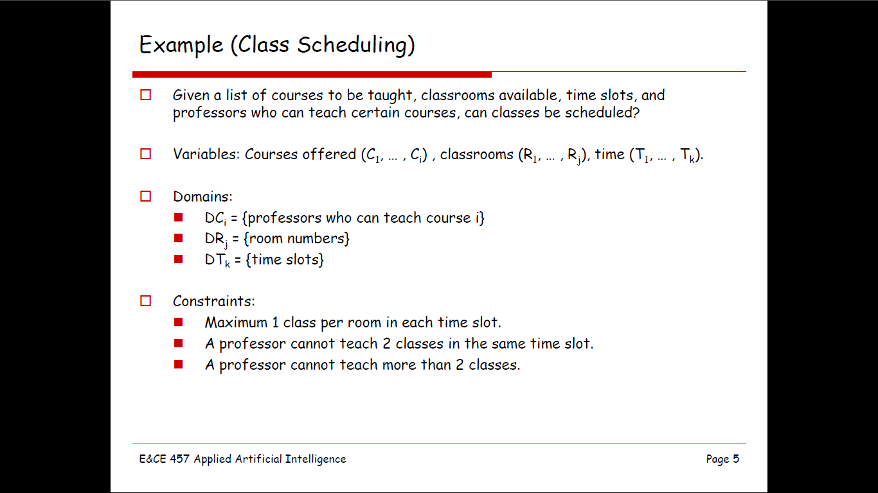


Slide 8
Typical Tasks for CSP
Solutions:
  Does a solution exist?
  Find one solution
  Find all solutions
  Given a partial instantiation, do any of the above
Transform the CN into an equivalent CN that is easier to solve.

Slide 9
Solving Constraint Problems
Systematic search
  Generate and test
  Backtracking
Constraint propagation (consistency)
Variable ordering heuristics
Value ordering heuristics
Backjumping and dependency-directed backtracking

Slide 10
Systematic Search: Backtracking
(a.k.a. depth-first search!)
Consider the variables in some order
Pick an unassigned variable and give it a provisional value such that it is consistent with all of the constraints
If no such assignment can be made, we’ve reached a dead end and need to backtrack to the previous variable
Continue this process until a solution is found or we backtrack to the initial variable and have exhausted all possible values

Slide 11
Problems with Backtracking
Thrashing: keep repeating the same failed variable assignments
  Consistency checking can help
  Intelligent backtracking schemes can also help
Inefficiency: can explore areas of the search space that aren’t likely to succeed
  Variable ordering can help

Slide 12
Consistency
Node consistency
  A node X is node-consistent if every value in the domain of X is consistent with X’s unary constraints
  A graph is node-consistent if all nodes are node-consistent
Arc consistency
  An arc (X, Y) is arc-consistent if, for every value x of X, there is a value y for Y that satisfies the constraint represented by the arc.
  A graph is arc-consistent if all arcs are arc-consistent.
To create arc consistency, we perform constraint propagation: that is, we repeatedly reduce the domain of each variable to be consistent with its arcs

Slide 13

Example: Map-Coloring
Variables WA, NT, Q, NSW, V, SA, T
Domains D_{i} = {red,green,blue}
Constraints: adjacent regions must have different colors
e.g., WA ≠ NT, or (WA,NT) in {(red,green),(red,blue),(green,red), (green,blue),(blue,red),(blue,green)}

Slide 14

Example: Map-Coloring
Solutions are complete and consistent assignments
e.g., WA = red, NT = green, Q = red, NSW = green,V = red,SA = blue,T = green

Slide 15

Constraint graph
Binary CSP: each constraint relates two variables
Constraint graph: nodes are variables, arcs are constraints

Slide 16
Varieties of constraints
Unary constraints involve a single variable,
  e.g., SA ≠ green
Binary constraints involve pairs of variables,
  e.g., SA ≠ WA
Higher-order constraints involve 3 or more variables,
  e.g., cryptarithmetic column constraints

Slide 17
Backtracking search
Variable assignments are commutative, i.e.,
[ WA = red then NT = green ] same as [ NT = green then WA = red ]
=> Only need to consider assignments to a single variable at each node
Depth-first search for CSPs with single-variable assignments is called backtracking search
Can solve n-queens for n ≈ 25

Slide 18

Backtracking search

Slide 19

Backtracking example

Slide 20

Backtracking example

Slide 21

Backtracking example

Slide 22

Backtracking example

Slide 23
Improving backtracking efficiency
General-purpose methods can give huge gains in speed:
  Which variable should be assigned next?
  In what order should its values be tried?
  Can we detect inevitable failure early?

Slide 24
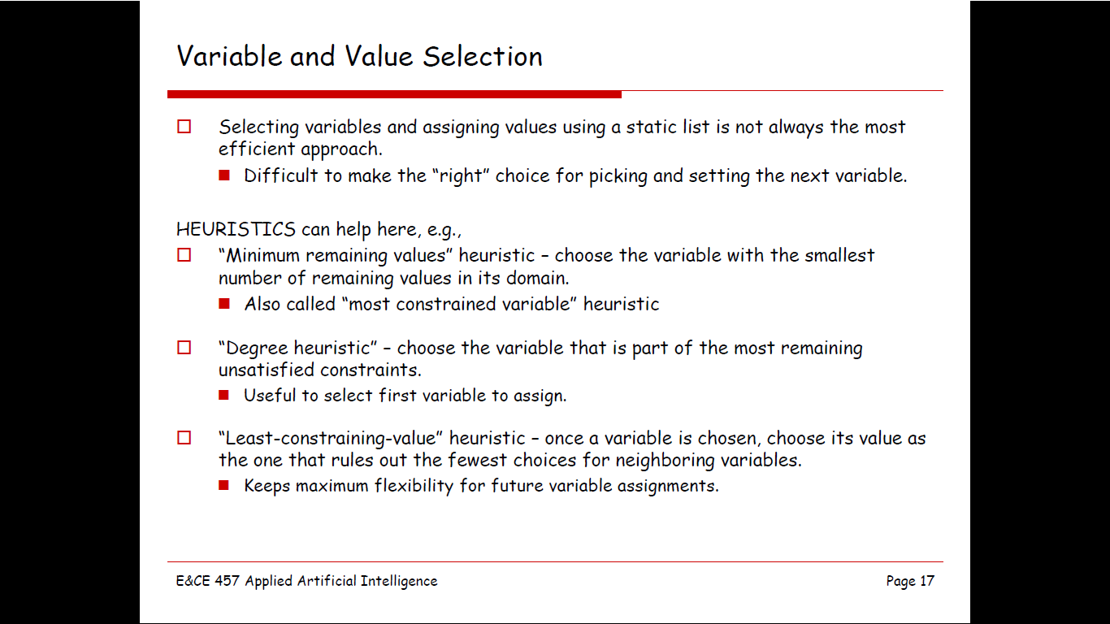

Slide 25

Most constrained variable
Most constrained variable:
  choose the variable with the fewest legal values
a.k.a. minimum remaining values (MRV) heuristic

Slide 26

Degree Heuristic
A good idea is to use it as a tie-breaker among most constrained variables
Most constraining variable:
  choose the variable with the most constraints on remaining variables

Slide 27

Least constraining value
Given a variable to assign, choose the least constraining value:
  the one that rules out the fewest values in the remaining variables
Combining these heuristics makes 1000 queens feasible

Slide 28

Forward checking
Idea:
  Keep track of remaining legal values for unassigned variables
  Terminate search when any variable has no legal values

Slide 29

Forward checking
Idea:
  Keep track of remaining legal values for unassigned variables
  Terminate search when any variable has no legal values

Slide 30

Forward checking
Idea:
  Keep track of remaining legal values for unassigned variables
  Terminate search when any variable has no legal values

Slide 31

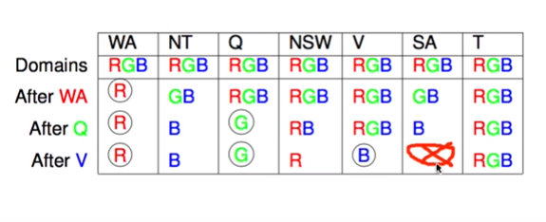
Forward checking
Idea:
  Keep track of remaining legal values for unassigned variables
  Terminate search when any variable has no legal values

Slide 32
Constraint propagation
Forward checking propagates information from assigned to unassigned variables, but doesn't provide early detection for all failures:
NT and SA cannot both be blue!
Constraint propagation algorithms repeatedly enforce constraints locally…

Slide 33

Arc consistency
Simplest form of propagation makes each arc consistent
X →Y is consistent iff
  for every value x of X there is some allowed y

Slide 34

Arc consistency
Simplest form of propagation makes each arc consistent
X →Y is consistent iff
  for every value x of X there is some allowed y

Slide 35

Arc consistency
Simplest form of propagation makes each arc consistent
X →Y is consistent iff
  for every value x of X there is some allowed y
If X loses a value, neighbors of X need to be rechecked

Slide 36

Arc consistency
Simplest form of propagation makes each arc consistent
X →Y is consistent iff
  for every value x of X there is some allowed y
If X loses a value, neighbors of X need to be rechecked
Arc consistency detects failure earlier than forward checking
Can be run as a preprocessor or after each assignment

Slide 37

Arc consistency algorithm AC-3
Time complexity: O(#constraints |domain|³)
Checking consistency of an arc is O(|domain|²)

